Slide 1

Graceful Degradation of the Milford Education Website
Increasing Usability for Small and Extra Small Screens

Slide 2
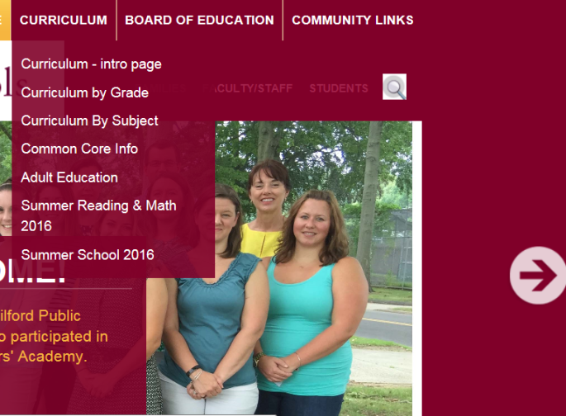


Graceful Degradation of the Milford Education Website
Current TR when minimized, note elements falling out of div
Current TL when minimized, note the negative margin on the logo
Debugged code, changed to width percentage, everything adjusts when minimized

Slide 3


Graceful Degradation of the Milford Education Website
Current BR when minimized, note elements falling out of div
Debugged code, changed to width percentage, everything adjusts when minimized

Slide 4
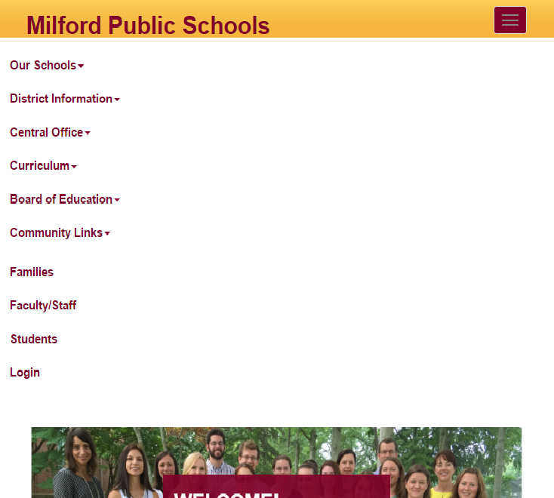

Graceful Degradation of the Milford Education Website
Graceful degradation with added toggle on screens smaller than 1200px using @media queries
Graceful degradation subNav added to toggle in xs screens

Slide 5


Graceful Degradation of the Milford Education Website
Graceful degradation sm and xs screens middle and bottom divs and text center
Graceful degradation xs screens middle and bottom text left

Slide 6
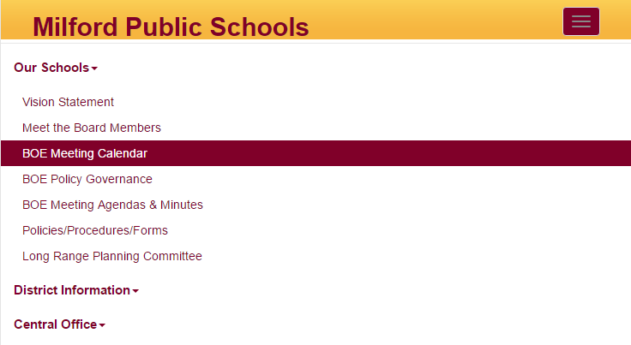
Graceful Degradation of the Milford Education Website
Added sleekness to the drop down and toggle

